Slide 1
Platforms Support SONiC
OCP Virtual Summit May12 ~ 15, 2020

Slide 2

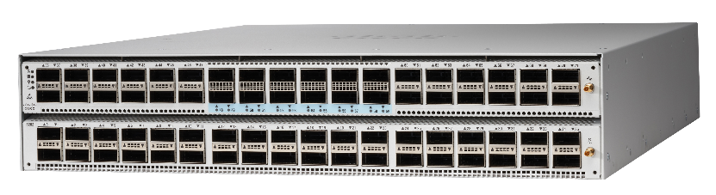
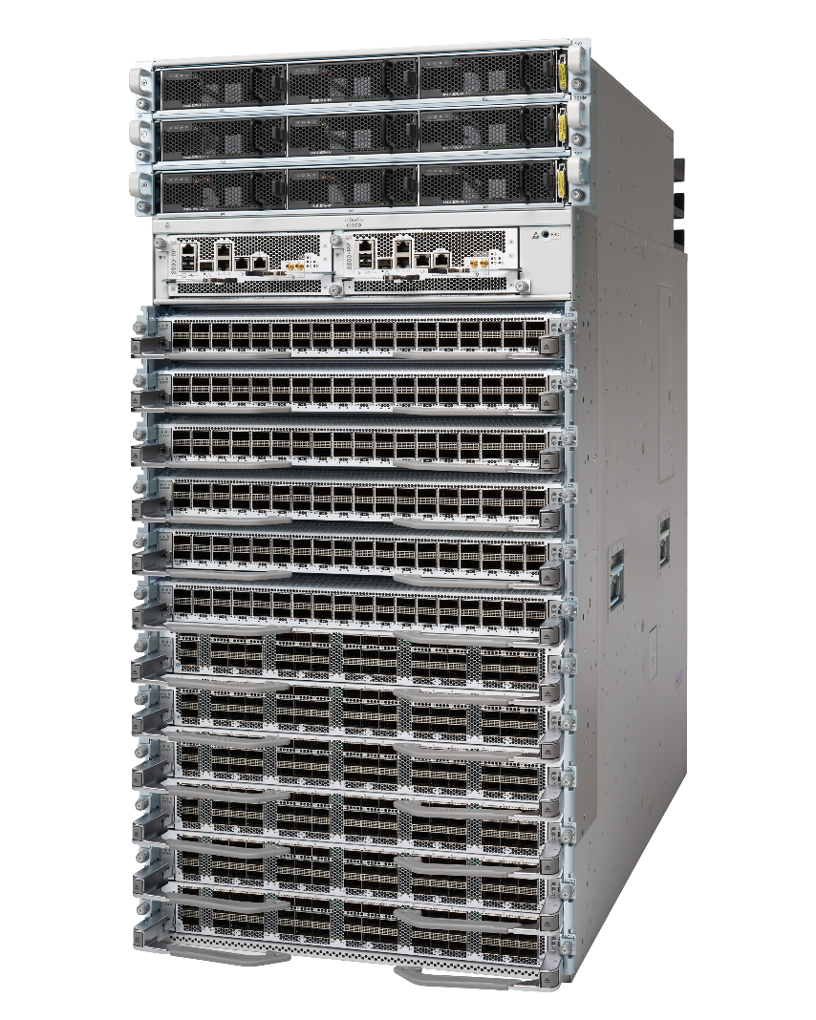
Cisco Switching Platforms supporting SONiC
Nexus Fixed Switches
Nexus 9232C
Nexus 92304QC
Nexus 9336C-FX2
Nexus 9364C
Nexus 9348GC-FXP
Nexus C93180YC-EX
Nexus 3132Q
Nexus 34180YC
Nexus 3464C
Nexus 3432D-S
Nexus 3232
Spitfire Single NPU Fixed
8201 (1RU)
8202 (2RU)
Spitfire Multi-NPU Distributed Systems
8808 (8 slot)
8812 (12 slot)
8818 (18 slot)

Slide 3

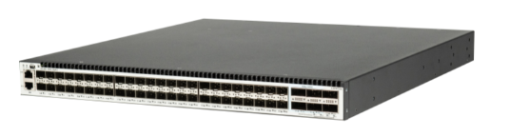
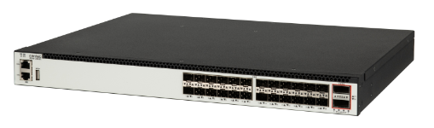
Centec E582 Series 10G/40G Switches
Centec CTC8096 Switch Silicon with Intel X86 CPU
Centec E530 Series 1G/10G Switches
Centec CTC7132 Switch Silicon, Embedded ARM CPU(A53 Dual Core)

Slide 4


SONiC on Intel Barefoot Tofino Platforms
Vendor | Platform Name
Arista | 7170-64C 7170-32C
Cisco | Nexus 34180
Edge-core | Wedge100BF-32x Wedge100BF-65x
DNI | AG9064v1
Inventec | D5264Q28 D5254
Ufi Space (Ingrasys) | S9180-32X S9280-64X
Stordis | BF6064X-T BF2556X-1T
Notes:
Future items: Ruijie, Stordis, Interface masters

Slide 5



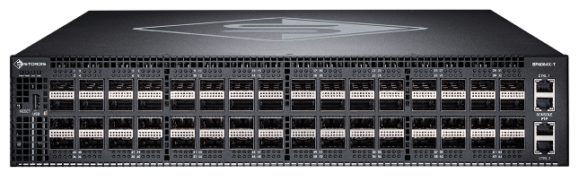
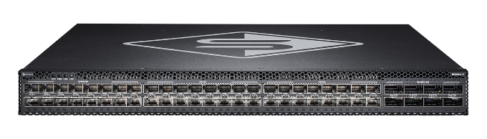
P4-Programmable OCP Switches
Advanced Programmable Switches with Built-in Time Synchronization
BF6064X-T
64x100G Switch
BF2556X-1T
48x10/25+8x100G Switch

Slide 6

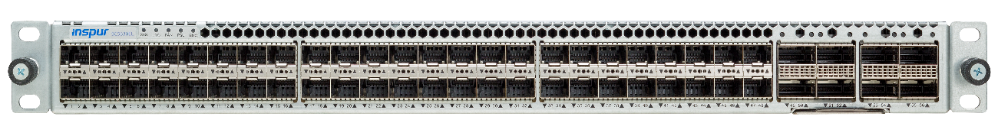
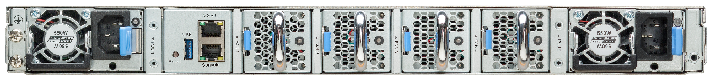
Inspur SC5630EL，1U 25GE TOR Switch
Item | SC5630EL
Ports | 48 * 1/10/25G (SFP28) 8 * 40/100G (QSFP28)
Management Interface | 1 * 10/100/1000M(RJ45) 1 * Console口 (RJ45) 1 * USB3.0
Switch ASIC | Broadcom Trident3 (BCM56873)
Switching capacity | 4T
CPU | Intel Broadwell-DE (D-1527)
RAM | DDR4 SODIMM*2
BMC | AST2520
Storage | M.2*2（240G)
Dimensions (H x W x D) | 43.5 x 441 x 470mm (H x W x D)
Weight | 9.2Kg
Front view
48 * 1/10/25GE
8 * 40/100GE
Back view
Management interface
3+1 redundant fan
1+1 power module

Slide 7
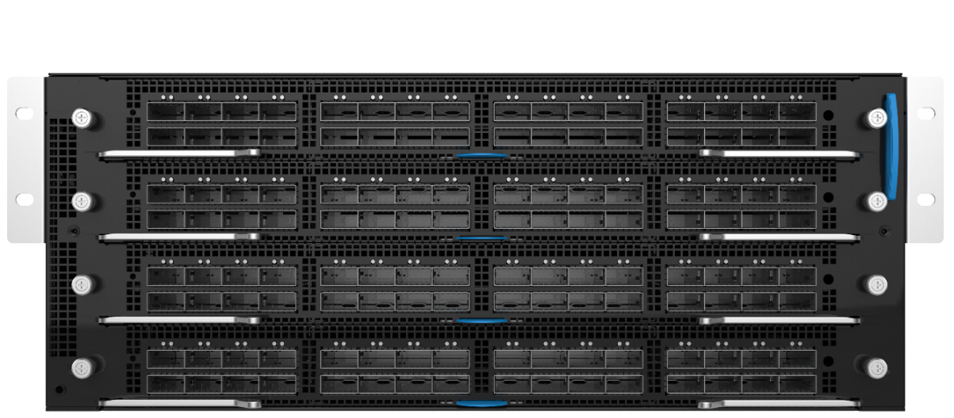
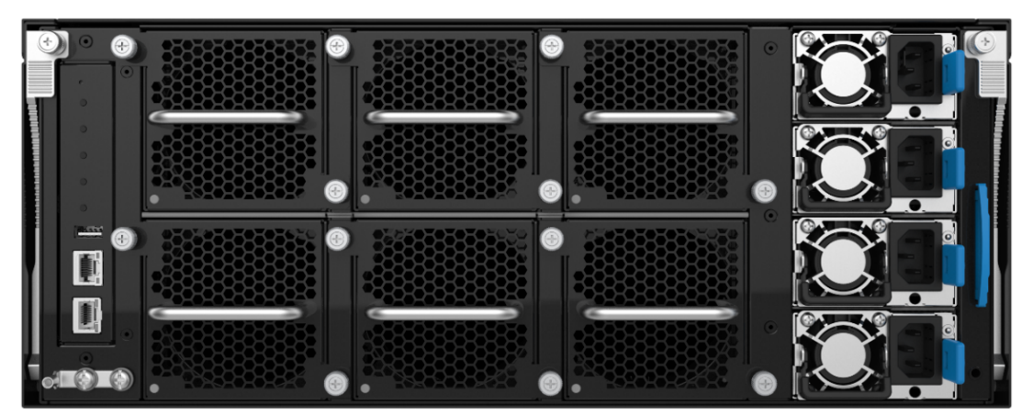
Inspur SC8661SL，4U Modular Aggregation Switch
Item | SC8661SL
Ports | 128 * 40/100G (QSFP28)
Slots | 4
Management Interface | 1 * 10/100/1000M (RJ45) 1 * Console port (RJ45) 1 * USB3.0
Switch ASIC | Broadcom Tomahawk (BCM56980)
Switching capacity | 25.6T
CPU | Intel Broadwell-DE (D-1527)
RAM | DDR4 SODIMM*2（16G）
BMC | AST2520
Storage | M.2*2（240G）
Dimensions (H x W x D) | 174.8 x 444 x 764mm (H x W x D)
Weight | 53kg
Front view
4 Interface Slots
128*40/100GE
Back view
Management I/O
5+1 redundant fan
2+2 power module

Slide 8

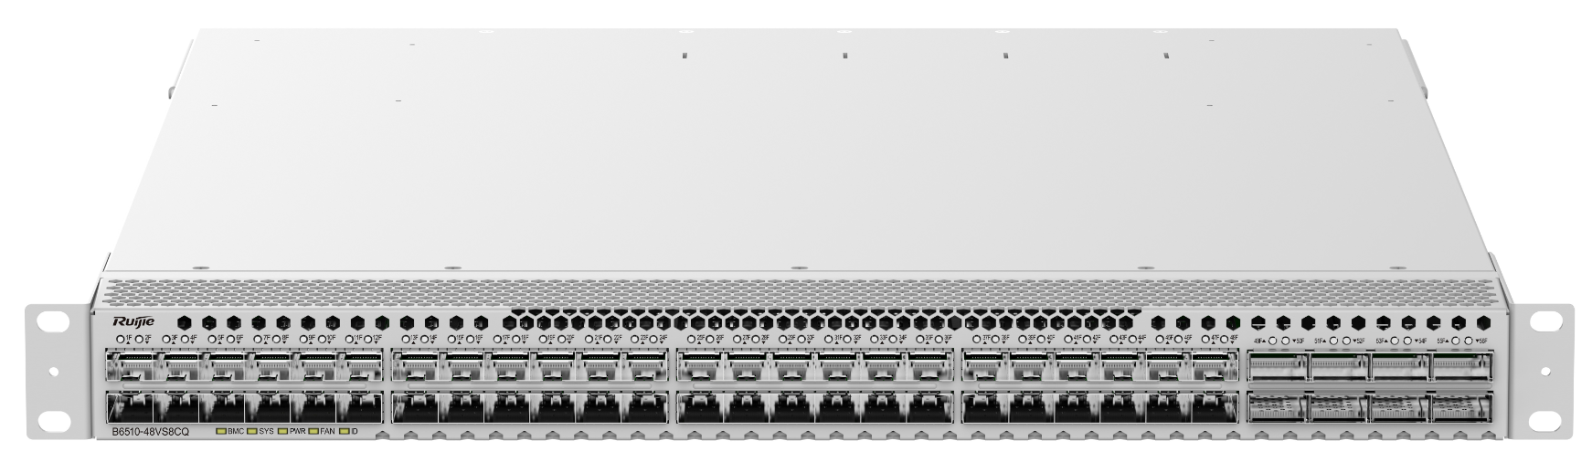
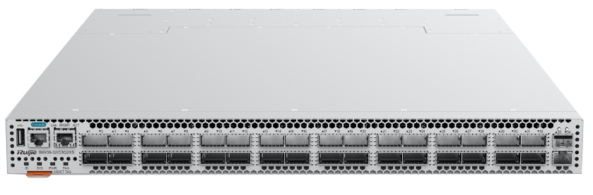
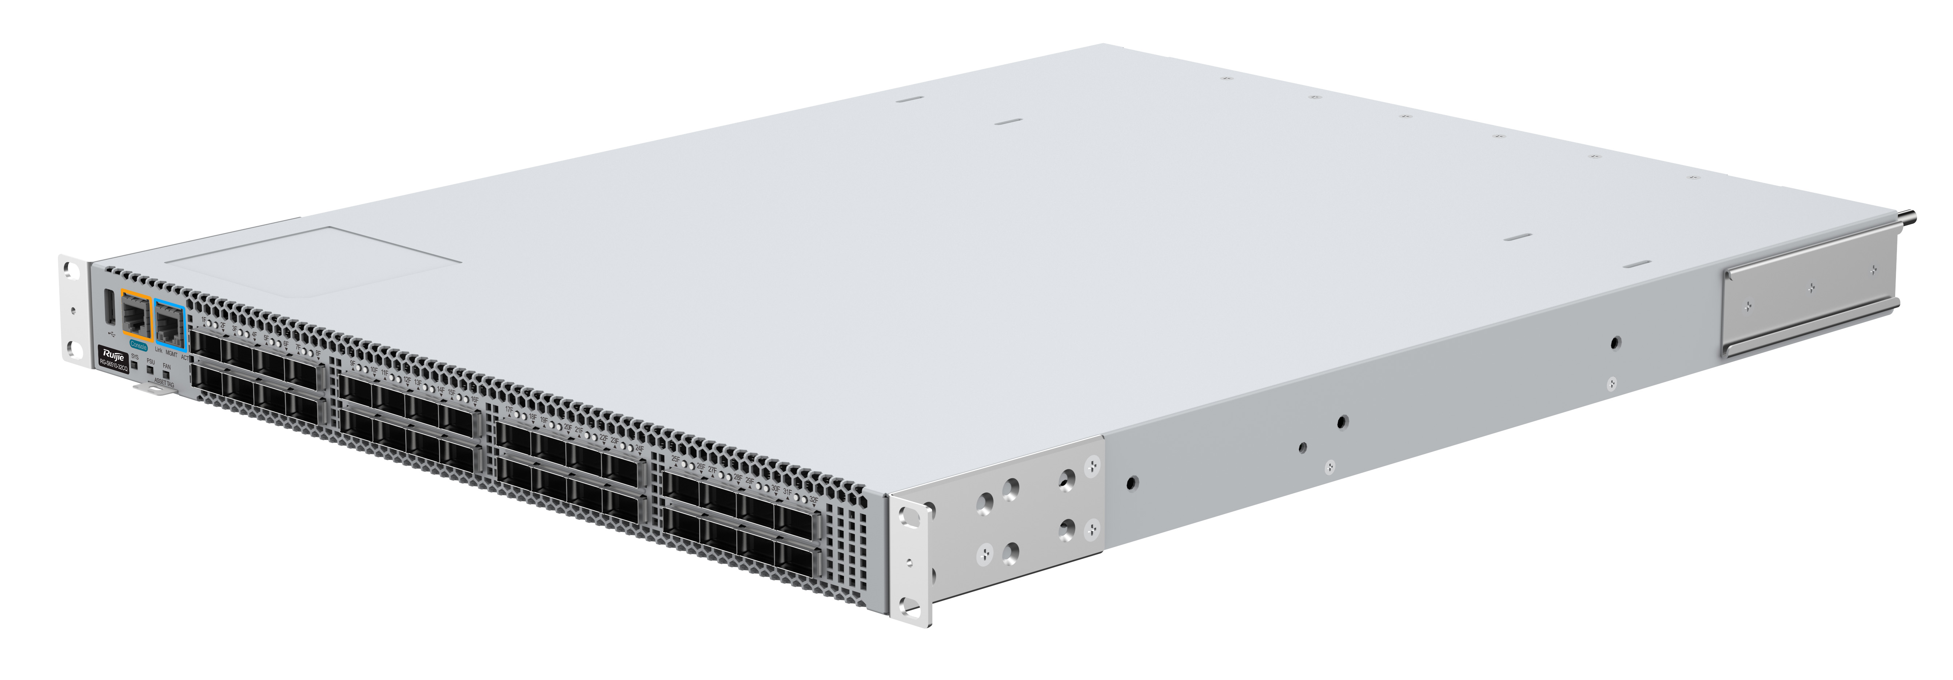
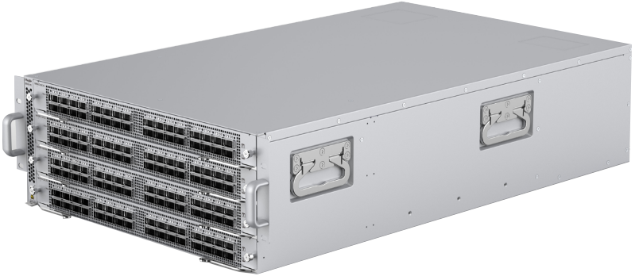
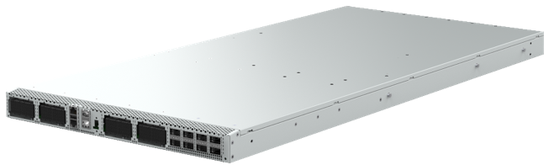
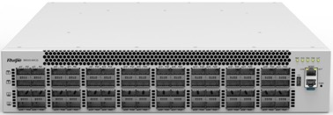
B6510-48VS8CQ
B6930-32CDQ2XS
B6510-32CQ
BS6500-32H
B6520-64CQ
B6920-4C

Slide 9
型号/Model | 规格/Spec | 备注/Note
B6510-48VS8CQ | BRCM TD3,48*25G(SFP28)+8*100G(QSFP28) | 1RU
B6520-64CQ | BRCM TH2,64*100G(QSFP28) | 2RU
B6920-4C | BRCM TH3,128*100G(QSFP28) | 4RU
B6930-32CDQ2XS | BRCM TH3，32*400G (QSFP-DD) + 2* 10G(SFP+) | 1RU
BS6500-32H | BRCM TH,48*50G+48*1G（Out-band） | Open19 Switch，1RU
B6510-32CQ | BRCM TD3，32*100G（QSFP28） | 1RU

Slide 10

Dell EMC PowerSwitch platforms
Model | Vendor | ASIC | Port Configuration
Dell EMC PowerSwitch Z9332F-ON | Dell Technologies | Broadcom Tomahawk 3 | 32x400G + 2x10G
Dell EMC PowerSwitch Z9264F-ON | Dell Technologies | Broadcom Tomahawk 2 | 64x100G + 2x10G
Dell EMC PowerSwitch Z9100-ON | Dell Technologies | Broadcom Tomahawk | 32x100G + 2x10G
Dell EMC PowerSwitch S6100-ON | Dell Technologies | Broadcom Tomahawk | 64x40G
Dell EMC PowerSwitch S5232F-ON | Dell Technologies | Broadcom Trident 3 | 32x100G + 2x10G
Dell EMC PowerSwitch S5248F-ON | Dell Technologies | Broadcom Trident 3 | 48x25G + 8x100G
Dell EMC PowerSwitch S6000-ON | Dell Technologies | Broadcom Trident 2 | 32x40G

Slide 11






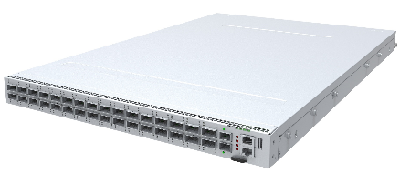
Celestica Switch platforms with SONiC
40G/100G+ Leaf / Spine
SEASTONE
32x100G X86
SEASTONE-2
32x100/40G
X86 / BMC / TMG
100G+ Fabric
MIDSTONE-200
64x200G 2U PAM4 Under developing
SILVERSTONE -DP
24xQ28+ 6xQDD
X86 / BMC / TMG
1G ToR / Management
HALIBURTON
48x1G + 4x10G X86
400G Leaf / Spine
SILVERSTONE
32x400G PAM4
SILVERSTONE-2
32x400G PAM4
Rapidly Growing Ecosystem

Slide 12

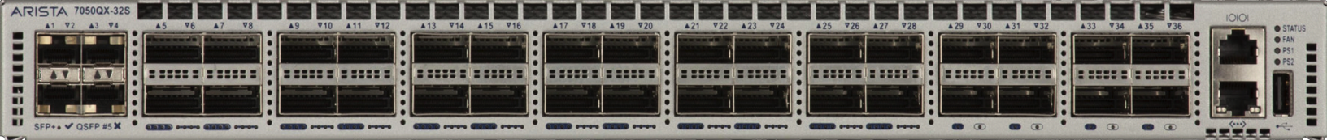
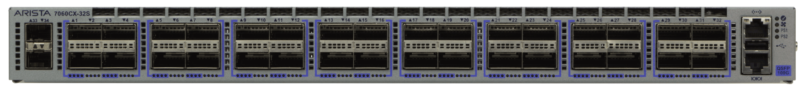
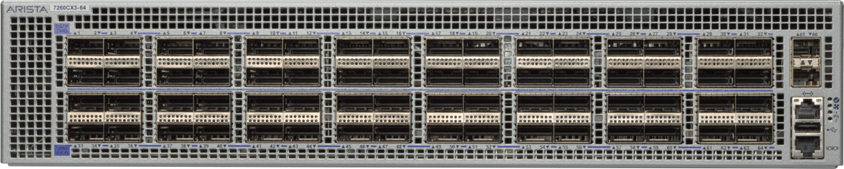
Arista Networks
SONiC Capable SKUs
7050QX-32, BRCM Trident2
32x40G
7050QX-32S, BRCM Trident2
32x40G
7050QX2-32S, BRCM Trident2+
32x40G
7050CX3-32S, BRCM Trident3
32x100G
7060CX-32S-ES, BRCM Tomahawk
32x100G
7280CR3-32P4, BRCM Jericho2
32x100G + 4x400G
7260CX3-64, BRCM
Tomahawk2
64x100G
7170-64C
BFN Tofino
64x100G

Slide 13

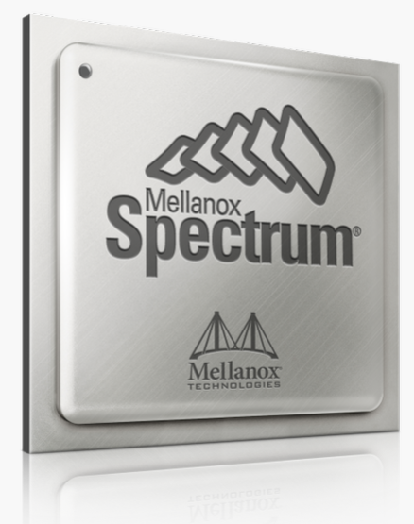
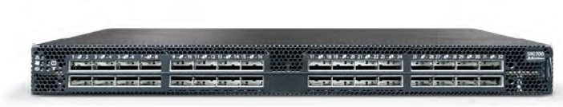
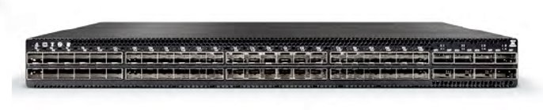
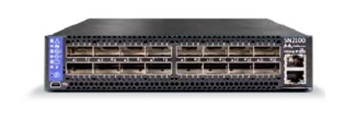
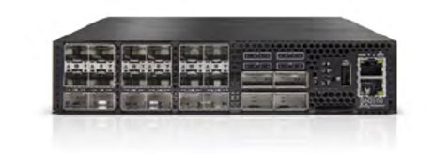
Nvidia/Mellanox Spectrum SONiC Supporting Platforms
Model Number | System Description
MSN2010-CB2FO | Spectrum based 25GbE/100GbE 1U Open Ethernet switch, 18 SFP28 ports and 4 QSFP28 ports
MSN2010-CB2RO | Spectrum based 25GbE/100GbE 1U Open Ethernet switch, 18 SFP28 ports and 4 QSFP28 ports
MSN2100-CB2FO | Spectrum based 100GbE 1U Open Ethernet switch, 16 QSFP28 ports,
MSN2100-CB2RO | Spectrum based 100GbE 1U Open Ethernet switch, 16 QSFP28 ports
MSN2410-CB2FO | Spectrum based 25GbE/100GbE 1U Open Ethernet switch , 48 SFP28 ports and 8 QSFP28 ports,
MSN2700-CS2FO | Spectrum based 100GbE 1U Open Ethernet switch, 32 QSFP28 ports,
MSN2700-CS2RO | Spectrum based 100GbE 1U Open Ethernet switch , 32 QSFP28 ports,
SN2700: 32x100G
SN2410: 48x25G + 8x100G
SN2100: 16x100G
SN2010: 18x25G + 4x100G

Slide 14
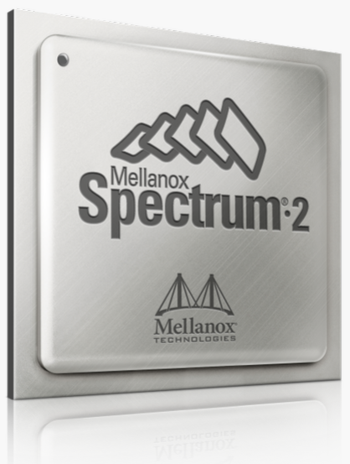
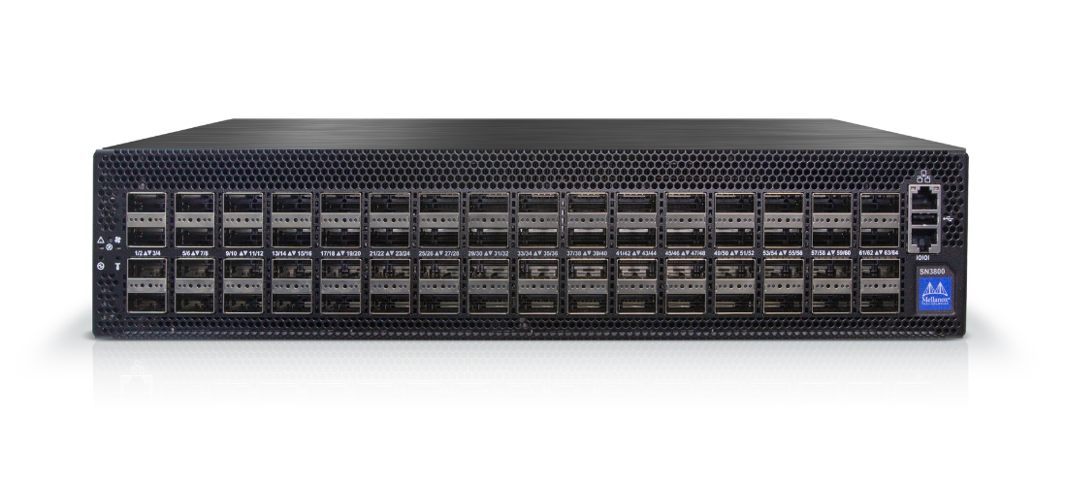
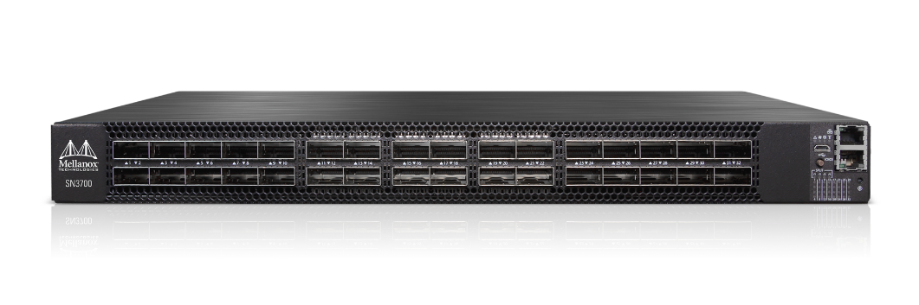
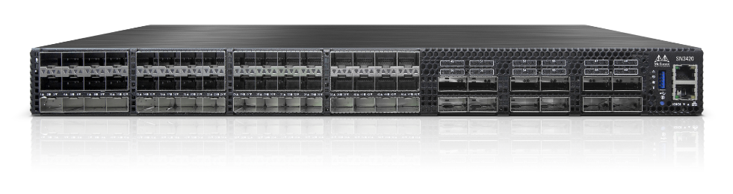
Nvidia/Mellanox Spectrum-2 SONiC Supporting Platforms
Model Number` | System Description
MSN3700-CS2FO | Spectrum-2 based 100GbE 1U Open Ethernet Switch , 32 QSFP28 ports
MSN3700-CS2RO | Spectrum-2 based 100GbE 1U Open Ethernet Switch , 32 QSFP28 ports
MSN3700-VS2FO | Spectrum-2 based 200GbE 1U Open Ethernet Switch , 32 QSFP56 ports
MSN3700-VS2RO | Spectrum-2 based 200GbE 2U Open Ethernet switch , 32 QSFP56 ports,
MSN3420-CB2FO | Mellanox Spectrum-2 based 25GbE/100GbE 1U Open Ethernet switch, 48 SFP28 ports and 12 QSFP28 ports
MSN3420-CB2RO | Mellanox Spectrum-2 based 25GbE/100GbE 1U Open Ethernet switch , 48 SFP28 ports and 12 QSFP28 ports
MSN3800-CS2FOS | Spectrum-2 based 100GbE 1U Open Ethernet Switch -SONIC, 64 QSFP28 ports
MSN3800-CS2ROS | Spectrum-2 based 100GbE 2U Open Ethernet switch -SONIC, 64 QSFP28 ports
SN3800: 64x100G
SN3700C: 32x100G
SN3700: 32x200G
SN3420: 48x25G + 12x100G

Slide 15
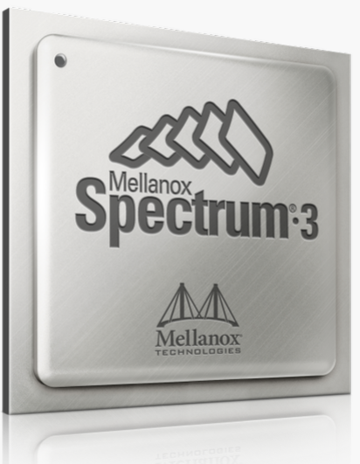
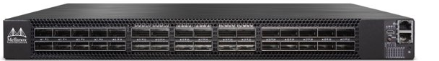
Nvidia/Mellanox Spectrum-3 SONiC Supporting Platforms
Model Number | System Description
MSN4700-WS2FO | Mellanox Spectrum-3 based 400GbE 1U Open Ethernet Switch , 32 QSFPDD ports
MSN4700-WS2RO | Mellanox Spectrum-3 based 400GbE 1U Open Ethernet Switch , 32 QSFPDD ports,
MSN4600-CS2FO | Mellanox Spectrum-3 based 100GbE 2U Open Ethernet Switch , 64 QSFP28 ports
MSN4600-CS2RO | Mellanox Spectrum-3 based 100GbE 2U Open Ethernet Switch , 64 QSFP28 ports
SN4700: 32x400G
SN4600C: 64x100G

Slide 16


Please contact Nokia to discuss our list of
enabled platforms.

Slide 17

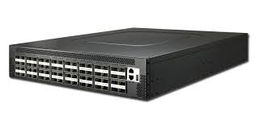
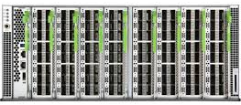
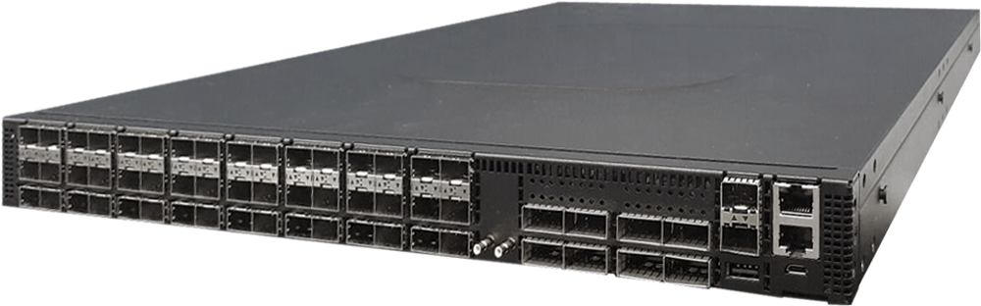
SONiC Supported Platforms
AS5812-54X – 48x10G + 6x40G AS5835-54X – 48x10G + 6xWSFP28, each supporting 2x100G, 1x40G, 4x25G, 4X10G AS7326-56X – 48x25G (SFP28) + 8xQSFP28, each supporting 2x50G, 4x25G, 1x40G or 4x10G AS7726-32X – 32xQSFP28 – each supporting 2x50G, 4x25G, or 4x10G AS7816-64X – 64xQSFP28 – each supporting 2x100G, 1x40G, 4x25G, 4X10G AS8000-Minipack - Modular system supporting a maximum of 128x100G or 32x400G

Slide 18

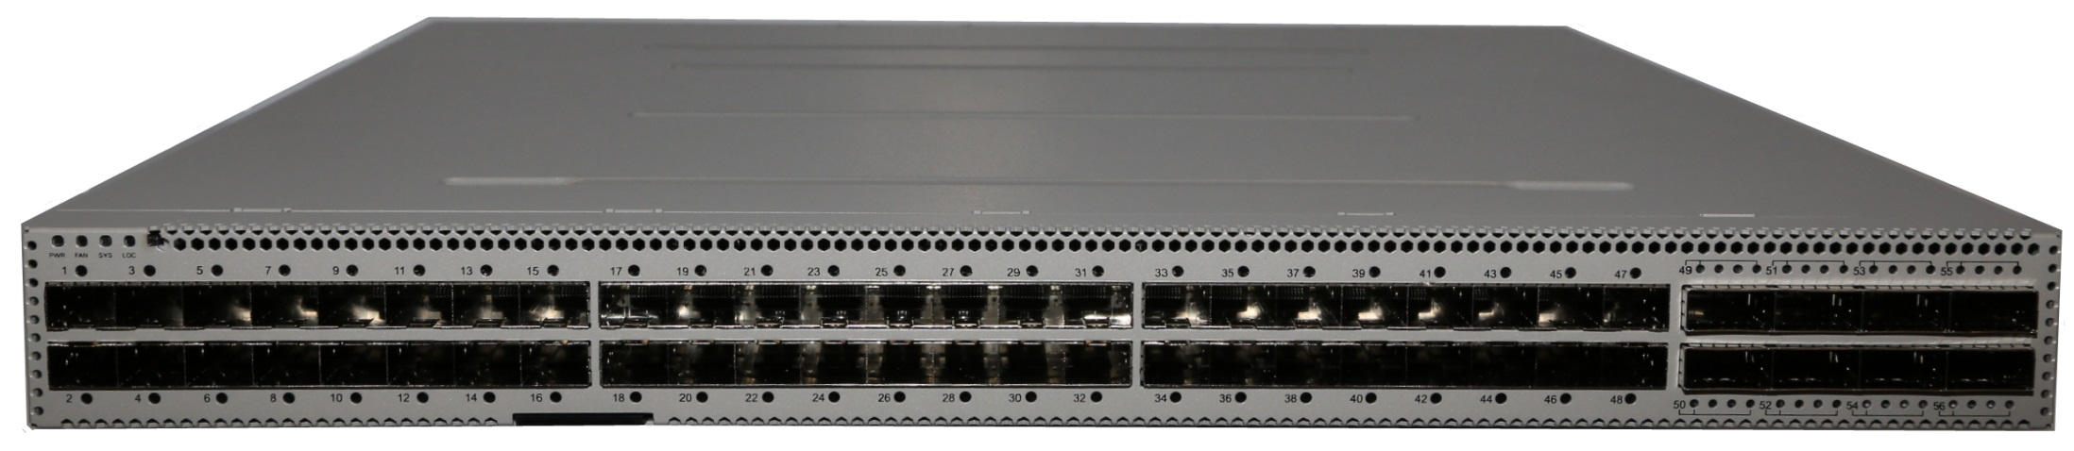
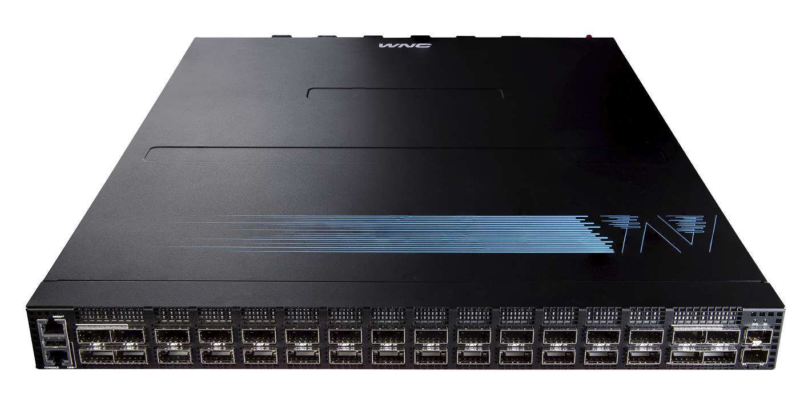
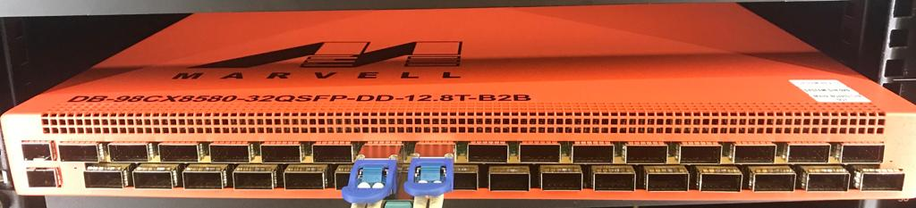
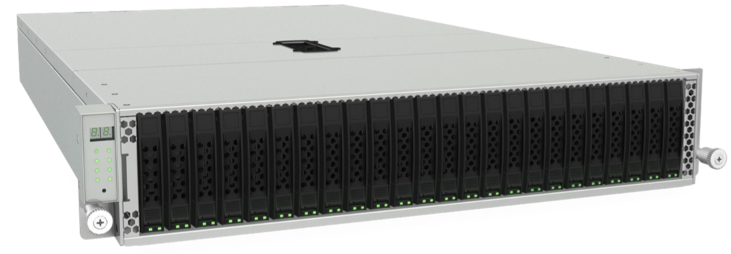
Marvell SONiC Platforms - Highlights
Platform | Configuration | ODM | Marvell Switch | CPU
 | 48x1G+4x10G | DNI | DX3200 | ARM32
 | 48x25G+8x100G | Pegatron | CX8512 | Intel
 | 32x400G | WNC | CX8580 | Intel
 | 32x400G | Marvell | CX8500 | ARM64, Intel
 | 6x200G + 24x25/50G 24xU.2 SSD Ethernet Bunch of Flash | Accton, Foxconn-Ingrasys | CX8522 | Intel

Slide 19

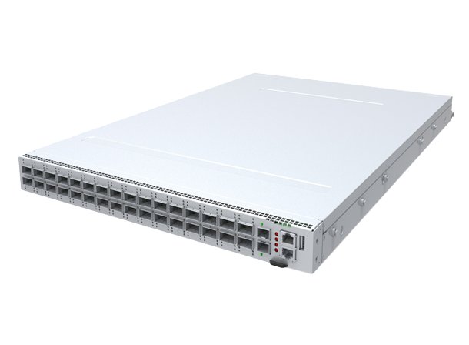
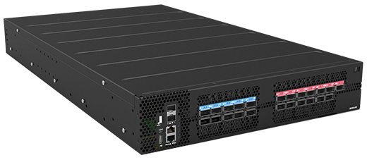
InsidePacket’s Supported Platforms
VxLAN
GW
DDOS
Firewall
Load Balancer
NAT
UPF
Containers
Celestica
SilverstoneDP
Ufi Space
S9700 53DX

Slide 20
Thank you!

